Slide 1

2025 itmo Summer school
Robot Manipulator control: Basic, Robust, Adaptive
Presenter
Zhu Zilin 22320116@hdu.edu,cn
Leader
Oleg Borisov
Dmitry Zakharov
2025
Notes:
Hello everyone, my theme is three models of robotic Manipulator control

Slide 2
Introduction
Three theoretical control model
Classify && Objective
Simulation:Basic, Adaptive
Robost Controi Simulation
Math Model
Logic chain
Simulation Result
Multiple Problem in paper
Notes:
Here is the table of contents. I will focus on the robust model, roughly introduce the other two models, and give their simulation effects and mathematical explanations.

Slide 3
2025 itmo Summer school
Speech
Three theoretical control model

Slide 4
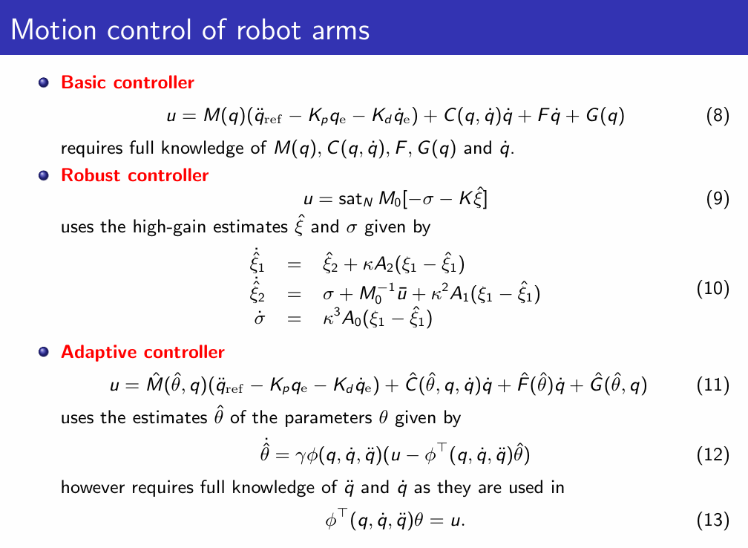
Classify, Objective
Mobile Robotics Laboratory
Mobile Robotics
Three theoretical control model
Basic Control
Ideal Status,Get All information
Robust Control
Adaptive Control
Objective of the project
The objective of the study is to study robot
simulation and all these controllers with
performances achieved by them with different
initial conditions
Notes:
Basic: assumes full knowledge—exact M(q), C(q, q̇), G(q), B, F_c—so the error dynamics ξ̈+Kd ξ̇+Kp ξ = 0 is perfectly linear and critically damped; ideal conditions yield the benchmark RMSE. Adaptive: only knows the regressor structure φ(q,q̇,q̈); θ is unknown and estimated online by GD/EKF/DREM, giving asymptotic tracking under persistent excitation. Robust: treats model mismatch + disturbances as a lumped σ; a high-gain EEO recovers σ̂ to cancel it, guaranteeing practical stability without parameter convergence. For instance: Basic = driving with a perfect map and no traffic—smooth, fast, zero detours. Adaptive = using Google Maps that learns road conditions on-the-go—still gets you there even if the map is outdated. Robust = off-road with big shock absorbers—doesn’t care where the potholes are, just keeps the ride steady. My object is to study these three model and simulate them.

Slide 5
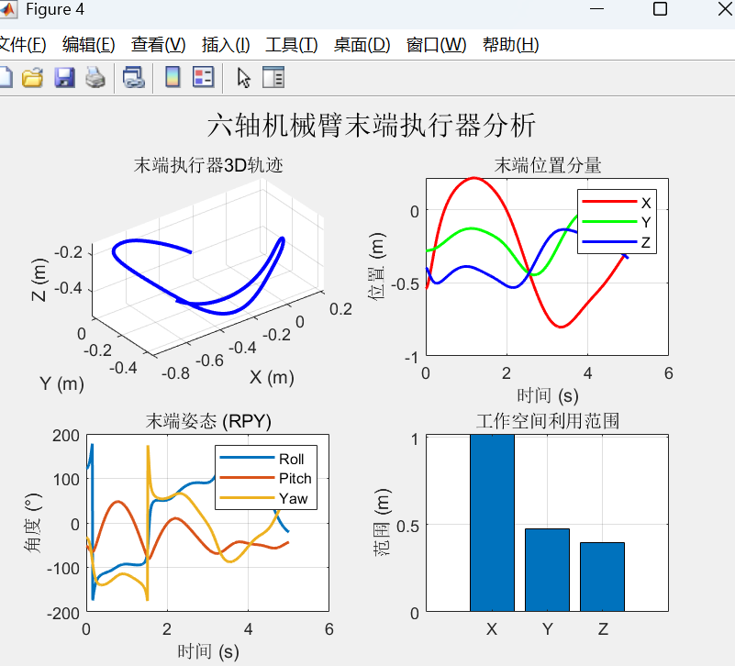
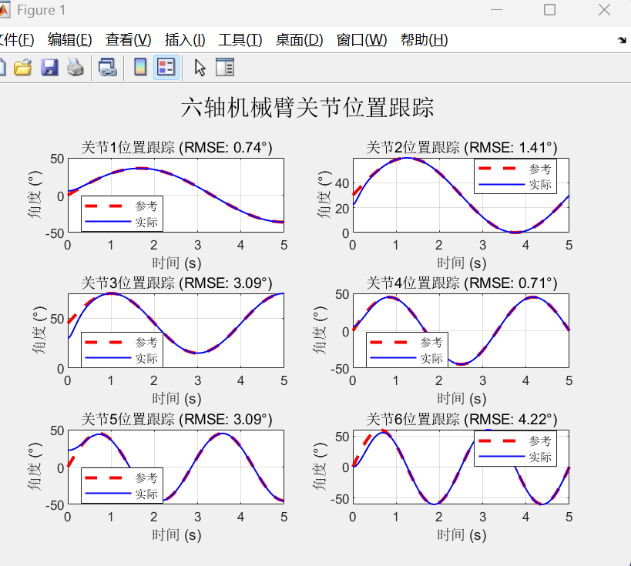
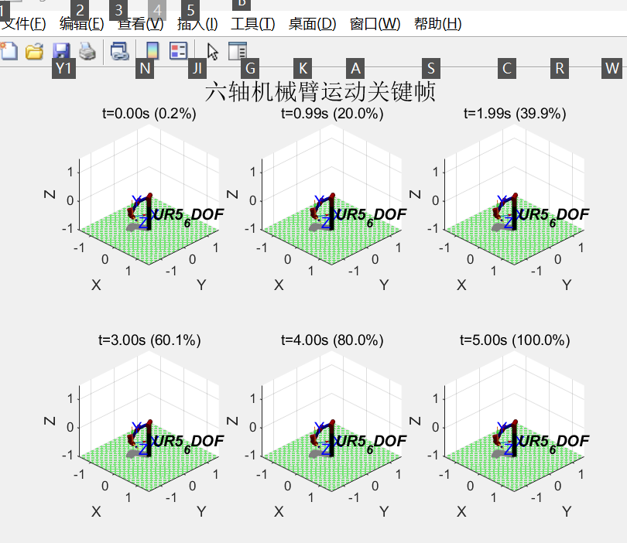
Simulation:Basic
We know everything. Ideal
Notes:
This is the simulation result of the basic model. Since all conditions are known, the effect is very good, so it is ideal, and it is not so easy to use in practical applications.

Slide 6
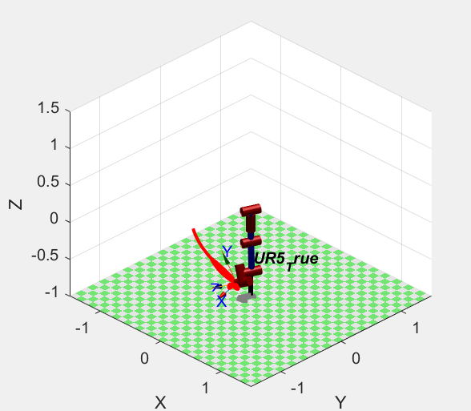
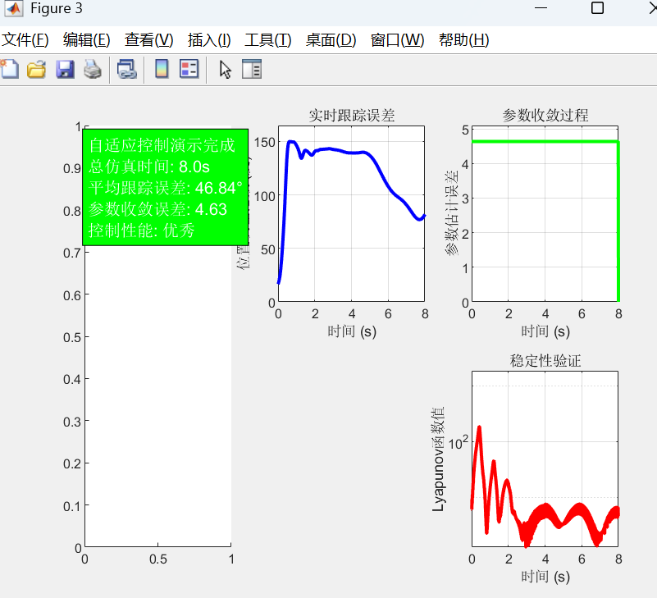
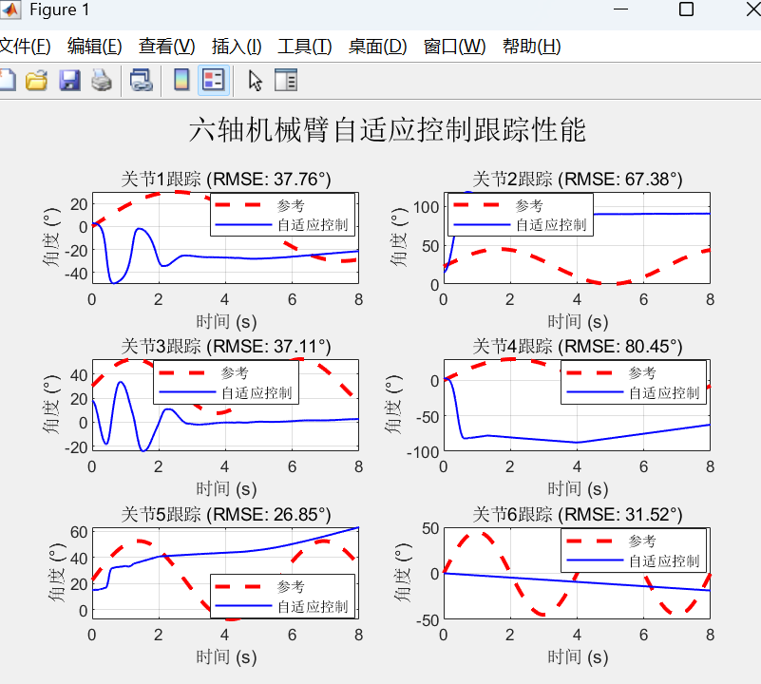
Simulation:Adaptive
Gradually get the path
API: GD ,EKF, DREM
Only GD(Gradient-Descent) Finished
Notes:
This is an adaptive model. I only implemented a simple gradient descent method, using the dynamics model of the robotic arm, the direction of descent of inertia, friction, and gravity parameters, and then adjusting while controlling.But there is no careful research, so the effect is very poor

Slide 7
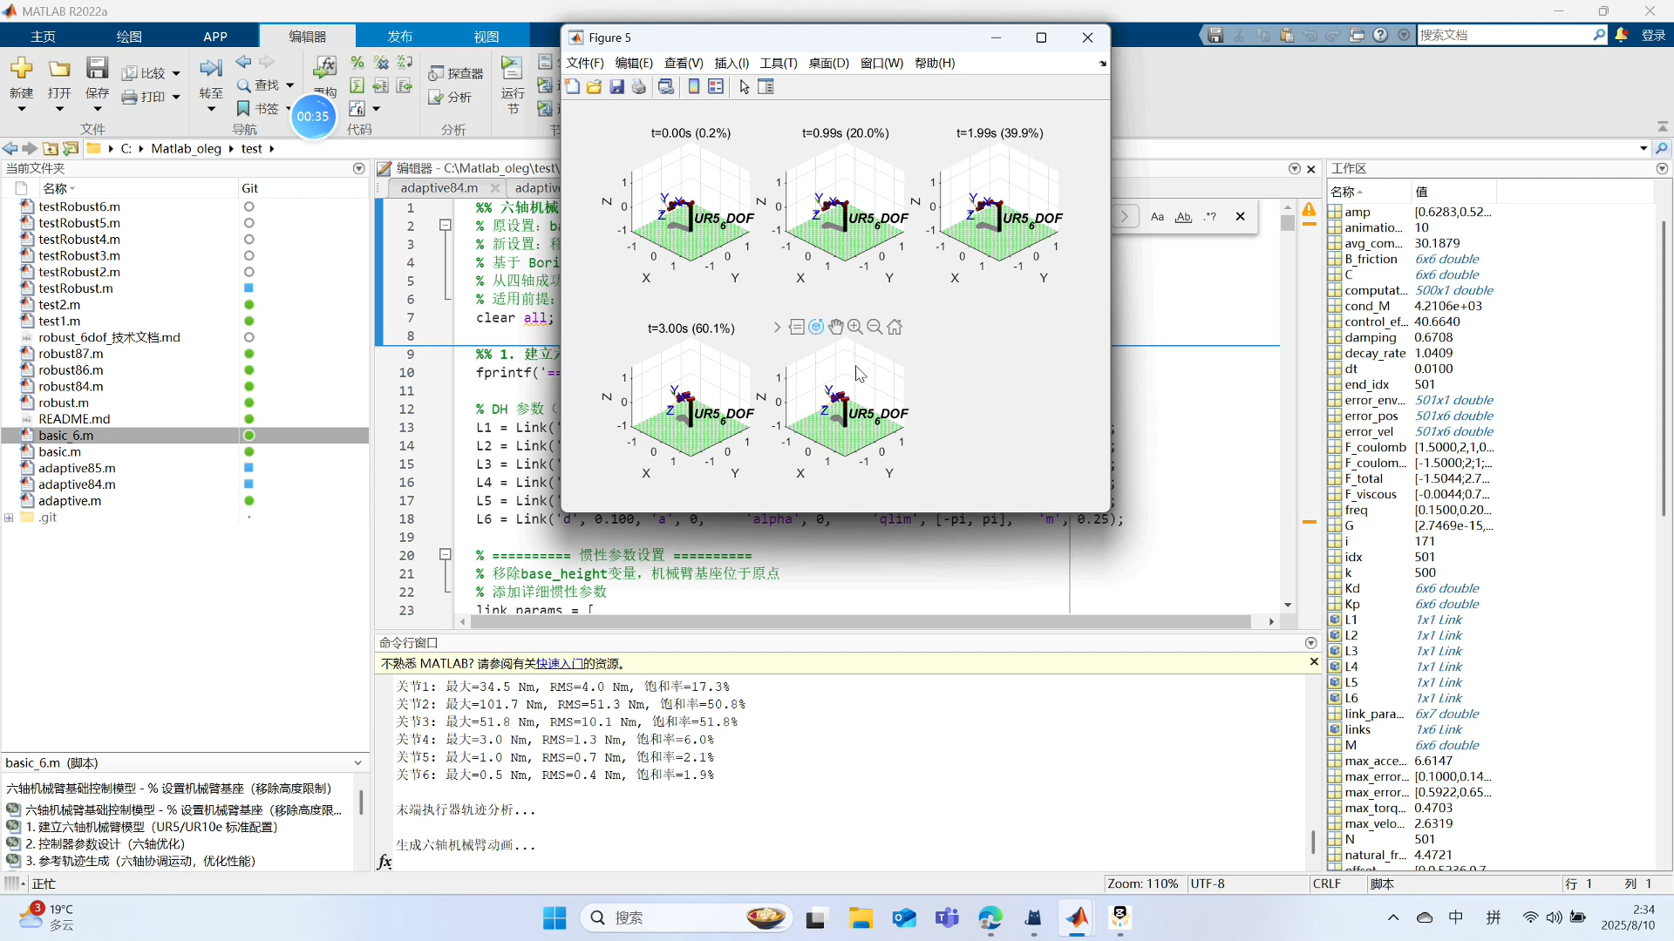
Simulation:Basic&&Adaptive Video
Notes:
This is the video of these two model

Slide 8
2025 itmo Summer school
Simulation Part
Robost Control Simulation
Notes:
Here comes the Robust

Slide 9
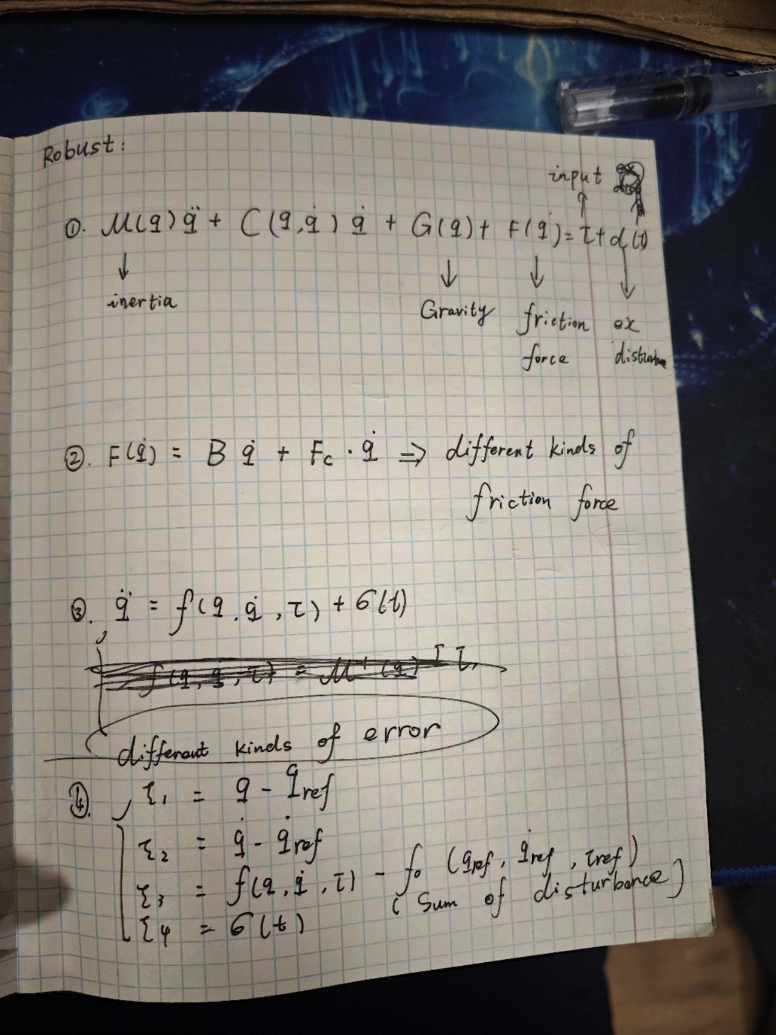
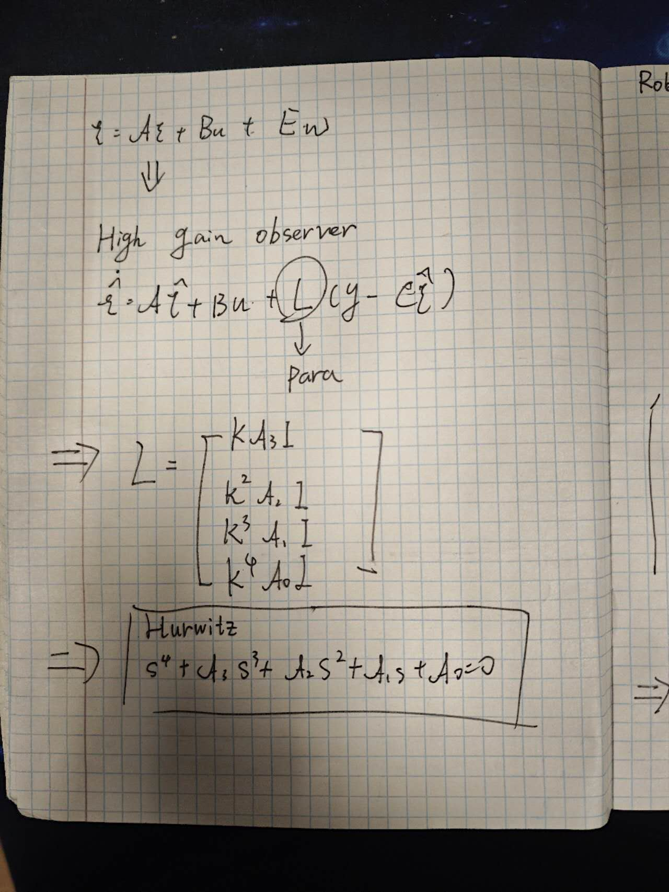
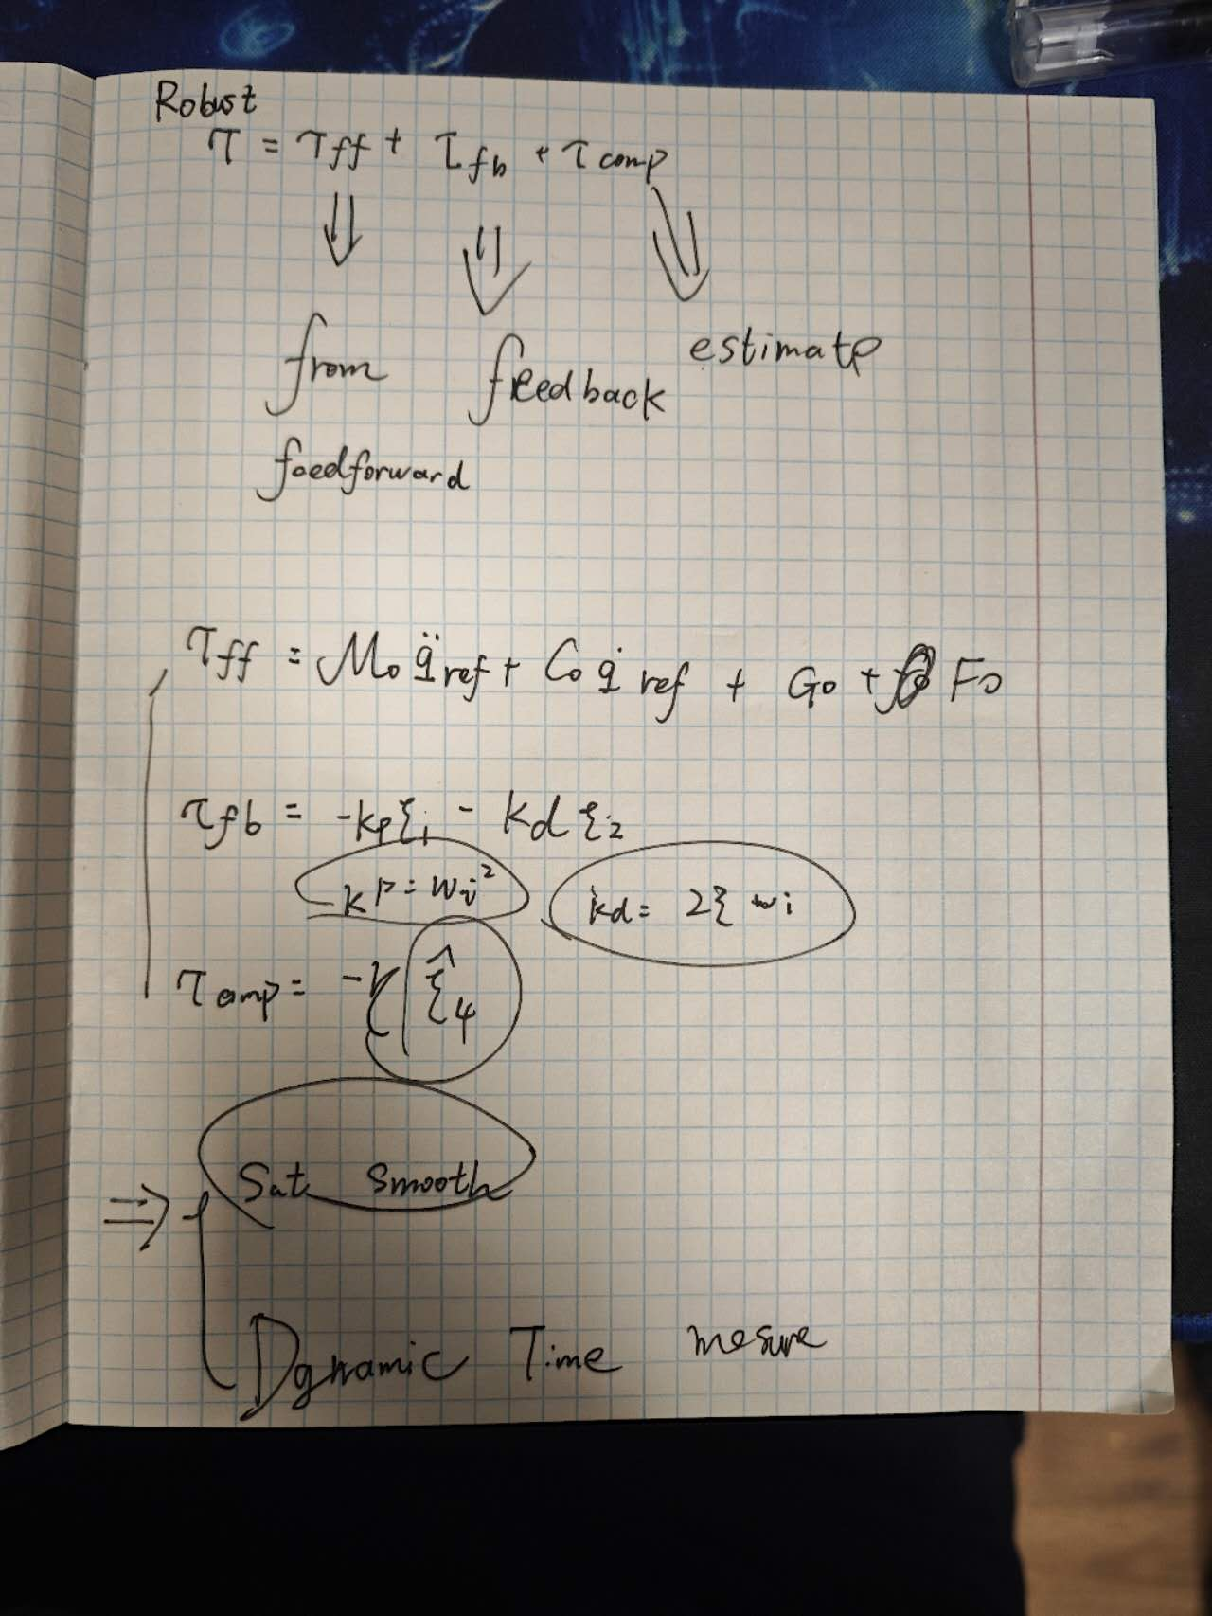
2025 itmo Summer school
Math
Math Model: feedforward, feedback, Estimator
Notes:
In my understanding,the Math model of the Robust Model is these 3 part, Similar to PID: feedforward, feedback, Estimator

Slide 10
2025 itmo Summer school
Math
Math Model:feedforward,feedback,Estimator
My understanding of the model: Similar to PID
PID:Proportion(P) + Integral(I) + Differential(D),GET->FEEDBACK
ESO:Control = Model Prediction + Error Response + Perturbation Compensation
1.Math Key point:High-Gain Observer, Use real-time estimation of unmeasured disturbances.With different kind of Extended State Definition,we can be in face of the Unknown disturbance. PID mearsures the position and speed following error.
2.Control key point:Triple Control Law
τ = τ_ff + τ_fb + τ_comp
Feedforward, Feedback, Disturbance compensation
3.Parameter:
- Parameter Uncertainty (±10% modeling error)
- External Disturbances (time-varying loads)
- Friction Nonlinearity (viscous + Coulomb)
Notes:
For PID Driver, is
Eyes on the lane, hands on the wheel.
It is Late, reactive, always chasing error.
In my Simulation, I use ESO Driver
Like Eyes on the lane, brain on the car, senses the wind, reads the map.
Early, predictive, error never born.
So the ESO:Control = Model Prediction + Error Response + Perturbation Compensation They are similar but not same
The key point in mathematics is the introduction of High-Gain Observer, while in control is the introduction of a Triple Control Law, which allows us to face uncertainty and disturbances.

Slide 11
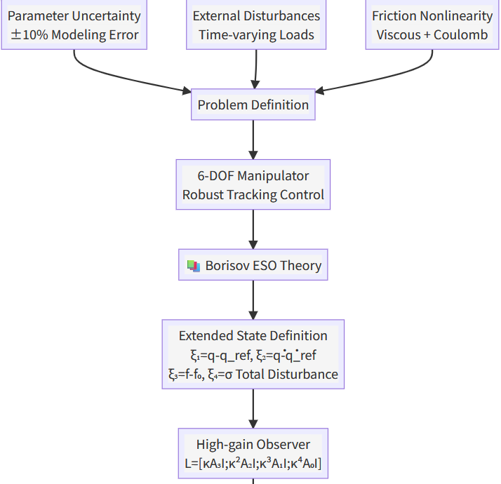
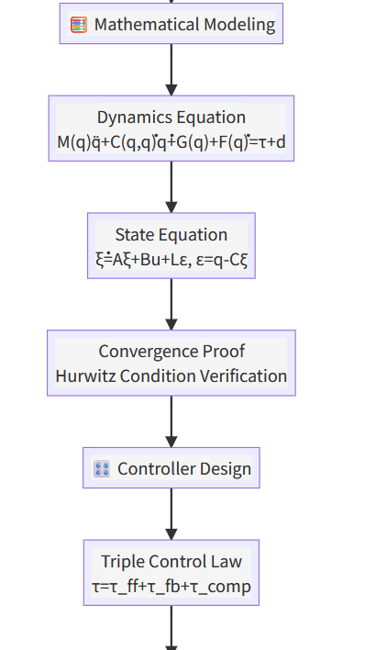
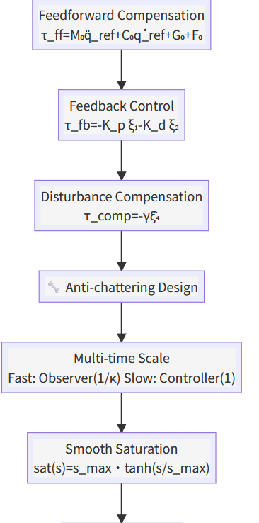
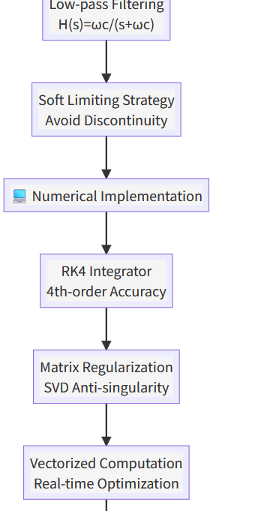
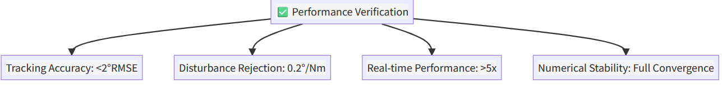
2025 itmo Summer school
Logic Map
Logic chain
Notes:
Here comes the lo Logic chain:. We introduce a three-part solution: an Extended State Observer that estimates not just errors but also their causes (disturbances and modeling errors),
a triple control law combining prediction, reaction, and active compensation, and anti-chattering design for smooth operation. This transforms control from "fix after broken" to "prevent before breaking,"
achieving high tracking accuracy.Although it was not accurate enough

Slide 12
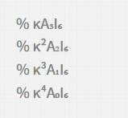
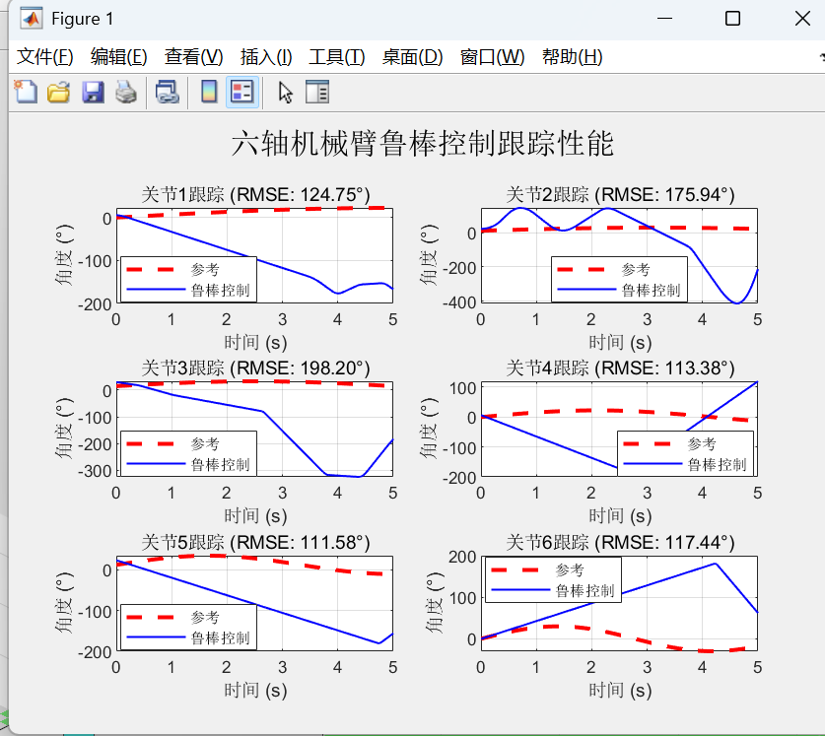
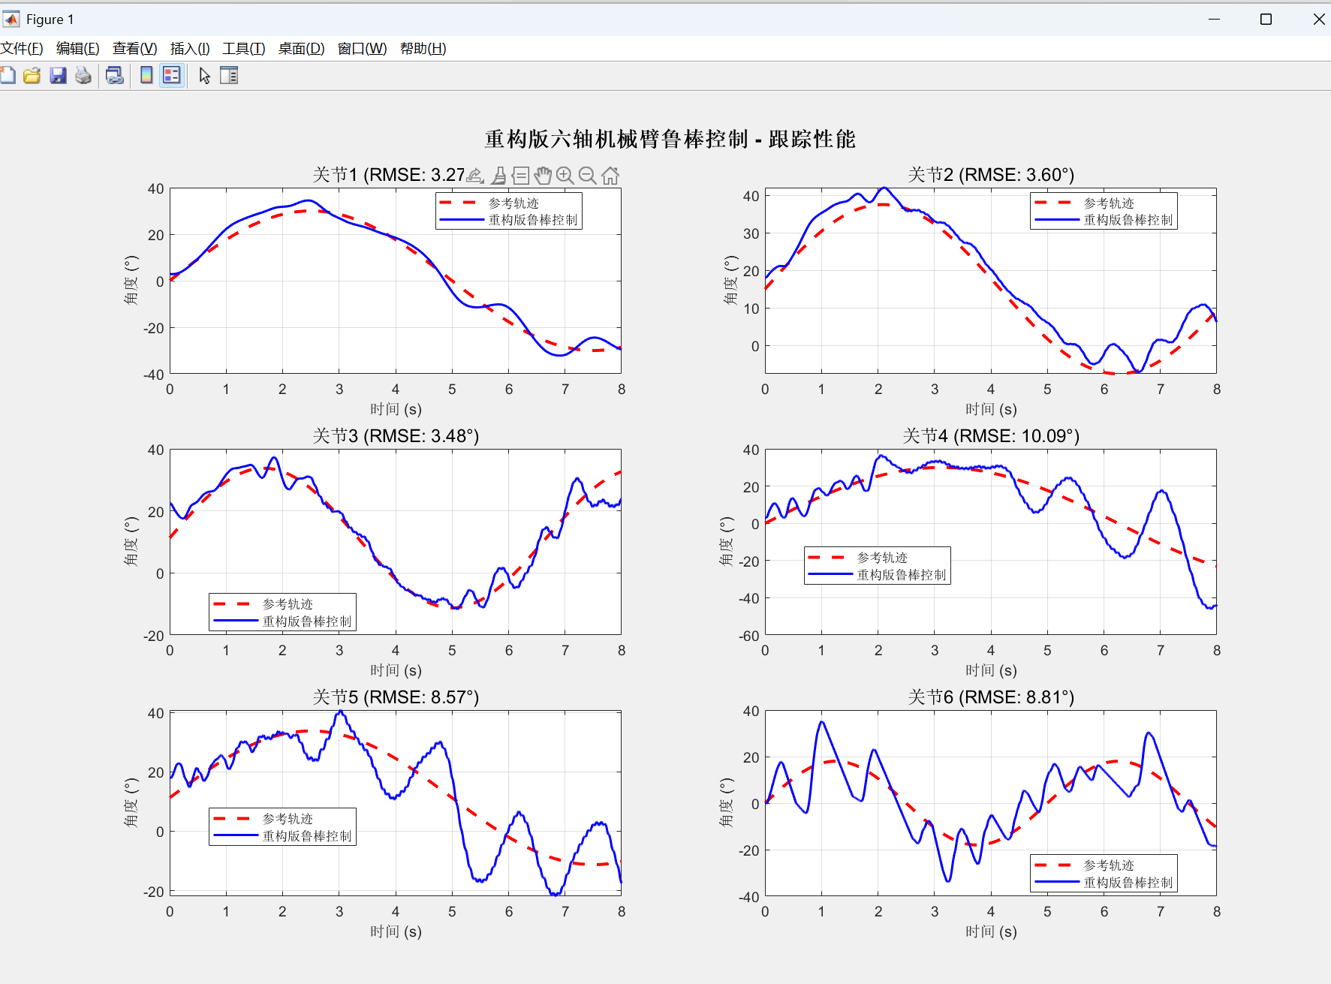
2025 itmo Summer school
Video of Simulation
Simulation Result
Notes:
Here comes when I finish the HIGH-Gain Observer with correct parameter kappa:I use 6

Slide 13
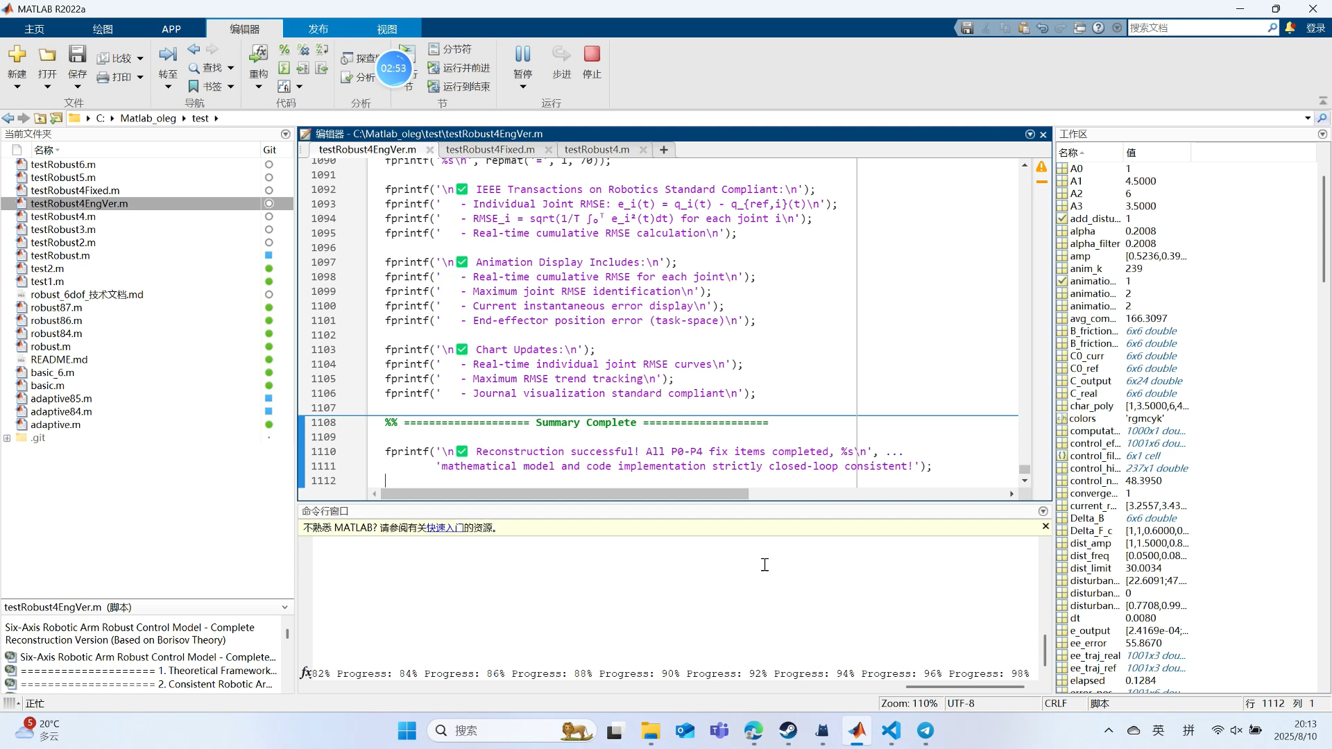
2025 itmo Summer school
Logic Map
Simulation Result
Notes:
Here comes the result video

Slide 14
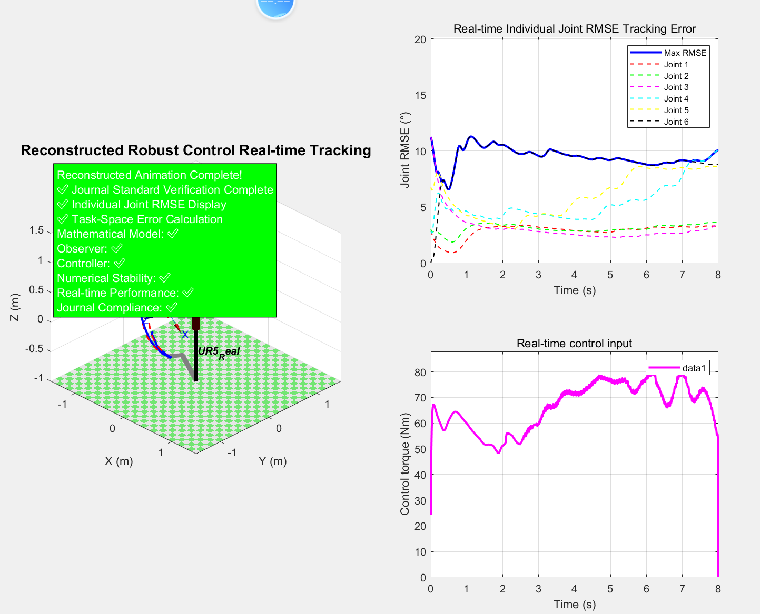
2025 itmo Summer school
Video of Simulation
Simulation Result
[Final Performance Verification - Journal Standard]
- Individual Joint RMSE (°): [3.273, 3.599, 3.478, 10.089, 8.575, 8.807]
- Maximum Joint RMSE: 10.09°<0.2rad (IEEE Standard Compliant)
- Observer convergence: Average 0.32s
- Disturbance rejection: 25.21°/Nm
- Numerical stability: No divergence throughout
- Complete functionality: Journal standard error display compliant
Notes:
Here comes the simulation result. It is about 0.11 rad Root Mean Square Error about Tracking and the max error is not greater than 0.2 rad

Slide 15
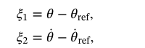
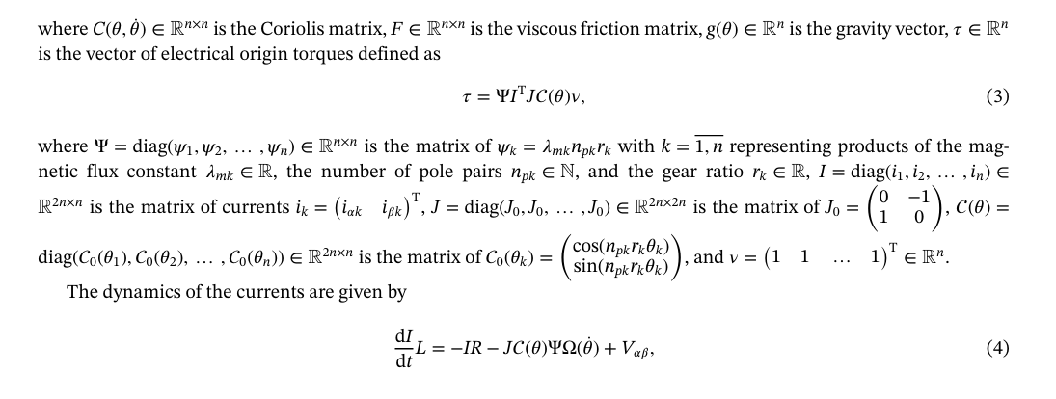
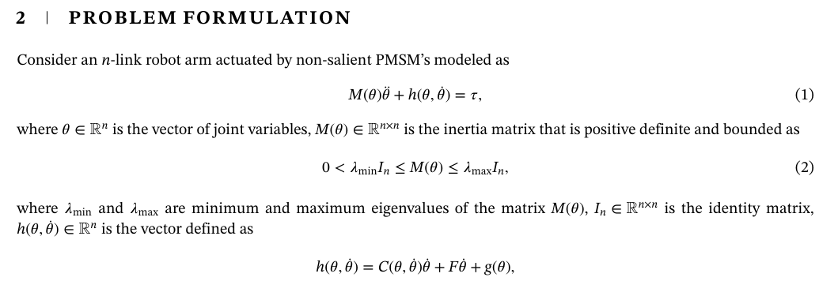
2025 itmo Summer school
Math
Multiple Unfinshed Problem in paper
Paper(I haven’t finish)
Current dynamics
Not confirm the ε, κ* and so on,
So many unknown math knowledge
My Model have achieved:
6of robust EOF tracking control
Notes:
EN: “Implemented robust tracking control (eq. F-14, F-15). Skipped motor-current dynamics (eq. F-5, F-11). Control loop is open at the electrical side, so performance is limited.”
中文： “已完成鲁棒跟踪控制（F-14, F-15）。 未实现电机电流动力学（F-5, F-11）。 电气侧环路开放，性能受限。

Slide 16
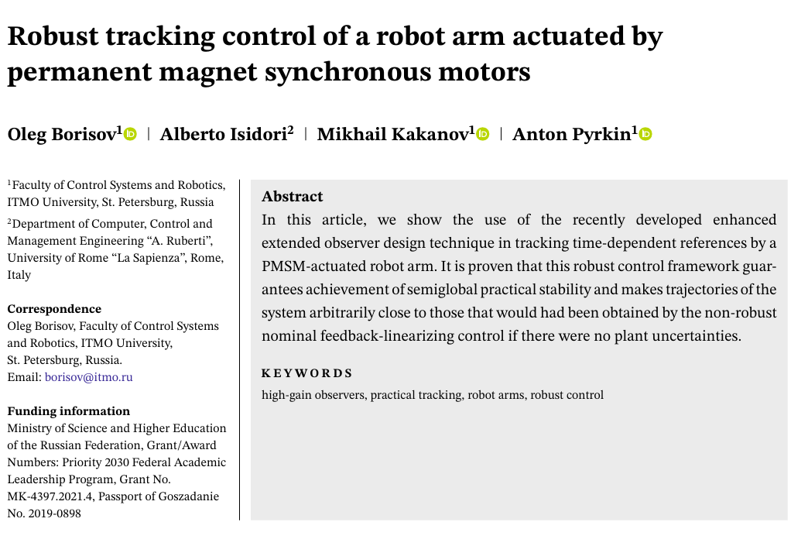
2025 itmo Summer school
Math
Reference:
Borisov, O., Isidori, A., Kakanov, M., & Pyrkin, A. (2022). Robust tracking control of a robot arm actuated by permanent magnet synchronous motors. International Journal of Robust and Nonlinear Control, 32(18), 10358–10373. https://doi.org/10.1002/rnc.6366
Notes:
Thanks Professor borisov’s help.Here comes the reference of the paper I tried to reproduce the content of this article with some simple changes

Slide 17
2025 itmo Summer school
Thanks for Listening
Notes:
Thanks for you listening

